Slide 1


B.N.M. Institute of Technology
An Autonomous Institution under VTU
Approved by AICTE, Accredited as Grade A Institution by NAAC till 31.12.2026.
All Eligible UG branches – CSE, ECE, EEE, ISE & Mech. Engg. Accredited by NBA till 30.06.2025
Post box no. 7087, 27th cross, 12th Main, Banashankari 2nd Stage, Bengaluru- 560070, INDIA
Ph: 91-80- 26711780/81/82 Email: principal@bnmit.in, www.bnmit.org
Internship II Seminar (23ECE158)
Digital Lock System with OTP Verification
Pavana P
1BG23EC077
Under the guidance of
Dr. Sameera P
Assistant Professor
Dept. of ECE, BNMIT

Slide 2
Contents
About the Company/ Organization.
About the Department (Department in which the student has taken up internship).
Project Details (objective, scope, description and methodology)
Results
References

Slide 3

Organisation
Cranes Varsity was established in 1998, incorporated as a private limited company on August 18, 2017 in the Headquartered in Bengaluru, Karnataka, India.
The company focuses on hands-on learning and skill development for engineers.
Specializations are Business Analytics,Embedded Systems & VLSI,Artificial Intelligence & Machine Learning,Full Stack Java Development,Internet of Things (IoT).
Notable Recruiters are Deloitte,Mphasis,Toshiba Transmission & Distribution Systems,Quikr,Zestl Software Pvt Ltd,Kaypro Technologies,Edvizo,Sun Fine Papers Pvt Ltd,Terminal Contacts,Isoftzone and many more.
Cranes Varsity is known for innovative teaching methods, blending theory with practical learning.

Slide 4
Internship stream-VLSI
VLSI (Very Large Scale Integration) department at Cranes Varsity provides comprehensive training on the entire chip design and verification lifecycle. The curriculum is focused on building industry-ready skills in critical areas.
Key Learnings:
Gained hands-on training in SystemVerilog programming for digital design & verification.
Learned Finite State Machines (FSM) design and implementation for sequential circuits.
Explored Event data type for synchronization in testbenches.
Worked with String & Enum data types for efficient coding and readability.
Practiced usage of Static & Dynamic Arrays for flexible data handling.
Focus on industry-oriented VLSI design concepts with practical applications.

Slide 5
Objective
To design a secure two-factor authentication (2FA) digital lock system.
To utilize a Finite State Machine (FSM) as the core controller to manage the lock's different operational states.
To create a comprehensive testbench to simulate and verify the design's functionality under various conditions.

Slide 6
Scope
The core digital logic for validating a static password followed by a One-Time Password (OTP).
A three-state FSM controller (LOCKED, PWD_OK, UNLOCKED).
Simulation of successful unlocking, incorrect password attempts, and incorrect OTP attempts.

Slide 7
Methodology
The system models a modern 2-step verification lock, enhancing security over a single password.
Step 1: Password Authentication
The user must first enter a pre-set 4-bit password.
If correct, the system transitions to an intermediate state, ready for the next step.
Step 2: OTP Verification
The system simulates "sending" an OTP by asserting the otp_send signal.
The user then enters the corresponding 4-bit OTP.
Unlocking Mechanism
Only when both credentials are provided correctly and in sequence does the lock_status output switch from 1 (Locked) to 0 (Unlocked).

Slide 8
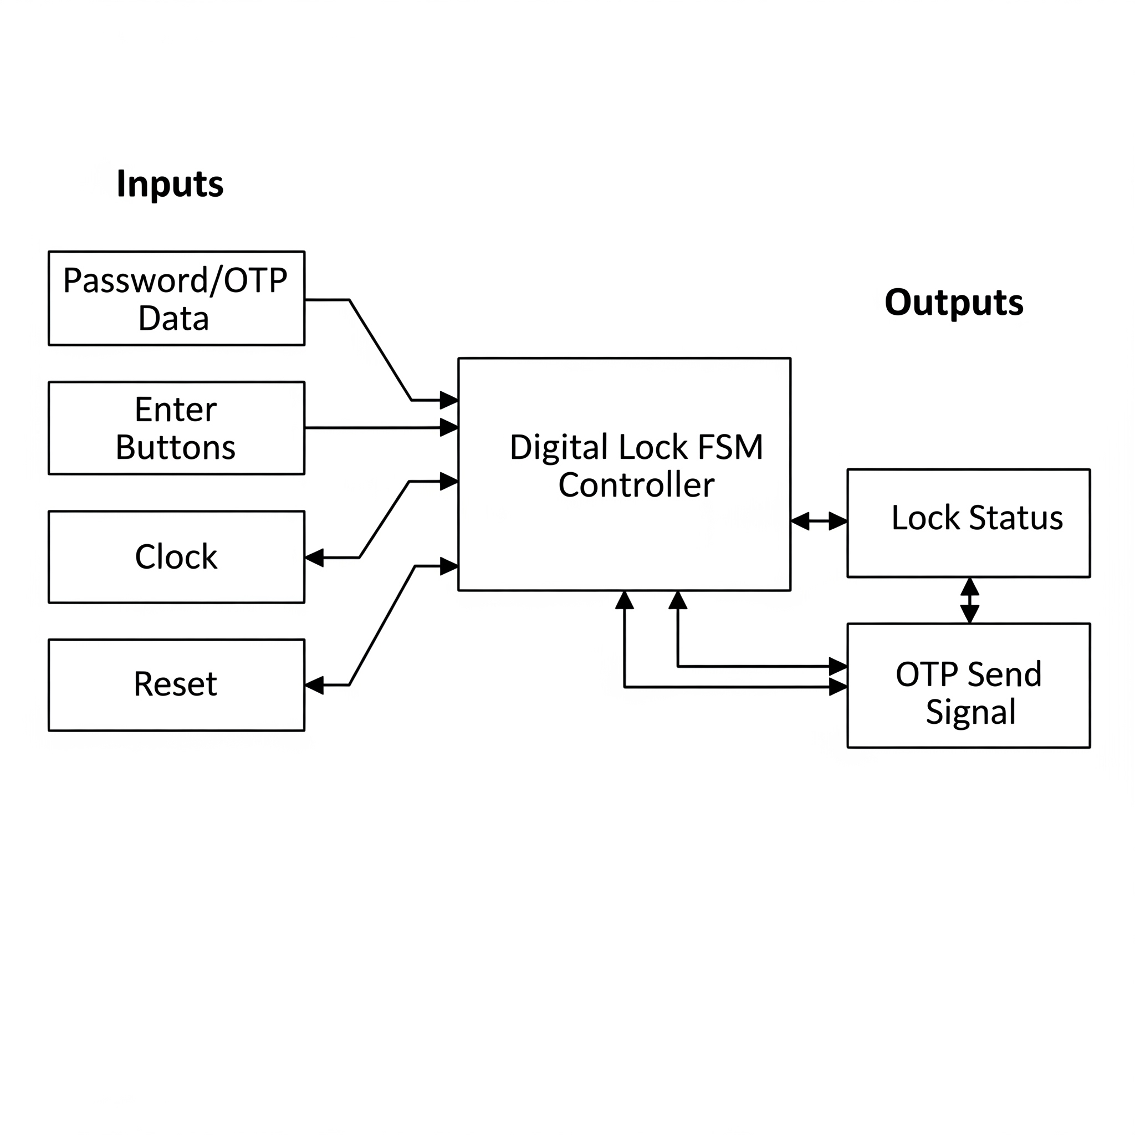
Block diagram

Slide 9
Design in Verilog
A behavioral model of the lock was created, centered around the three-state FSM. The logic for state transitions and outputs was defined in an always block.
Testbench Creation
A dedicated Verilog testbench module was written to instantiate the design and generate the necessary clock and input signals.
Simulation Scenarios
The testbench was programmed to apply a realistic sequence of stimuli to rigorously test the design for System reset,An correct/incorrect password attempt,A final correct OTP attempt.
Verification & Analysis
The code was compiled and simulated using EDA Playground. The resulting digital waveform and console logs were carefully analyzed to confirm that the circuit behaved exactly as intended.

Slide 10
Results
The simulation successfully verified the complete functionality of the digital lock system.
The output waveform clearly demonstrates that:
The lock remains secure (lock_status = 1) when incorrect passwords or OTPs are entered.
The lock_status transitions to 0 (Unlocked) only after the entire correct sequence is completed.
The system is proven to be robust and functions precisely as per the initial design objectives

Slide 11
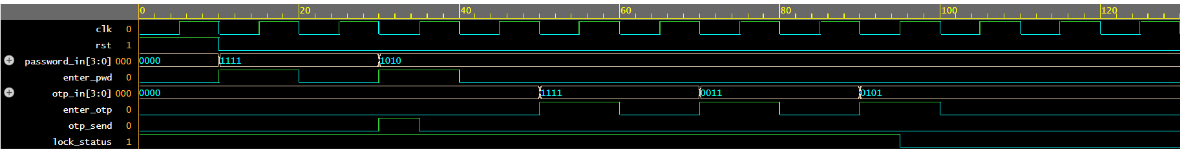
The waveform shows the digital lock system operation.
Initially, the system is in LOCKED state (lock_status = 1).
A wrong password (1111) is entered but the system remains locked.
On entering the correct password (1010), the FSM moves to the PWD_OK state and otp_send pulses high, simulating OTP delivery.
Two wrong OTP attempts (1111, 0011) keep the system locked.
On the correct OTP (0101), the FSM transitions to UNLOCKED and lock_status goes low, successfully opening the lock.
This demonstrates proper two-factor authentication and multiple OTP retry handling.

Slide 12
Future Scope
Physical hardware implementation (FPGA/ASIC synthesis).
Advanced features like an attempt counter or automatic re-locking.

Slide 13
References
P. S. Navale and S. R. Patil, "FPGA Based Digital Lock System Using RFID and Password," International Journal of Advanced Research in Electrical, Electronics and Instrumentation Engineering, Vol. 4, Issue 5, May 2015, pp. 4102-4106.
M. A. A. Rahman and Z. A. Zukarnain, "Implementation of One-Time Password Algorithm on Embedded System," 2012 International Conference on Computer and Communication Engineering (ICCCE), Kuala Lumpur, July 3-5, 2012, pp. 658-662.
A. K. Sah, A. Barik, and A. Pradhan, "Design and Implementation of Digital Number Lock System Using Finite State Machine," International Journal of Engineering Research & Technology, Vol. 6, Issue 04, April 2017.
K. Anvekar and S. Banakar, "A Verilog Implementation of a Digital Combination Lock based on a Finite State Machine," International Journal of Computer Applications, Vol. 118, No. 3, May 2015, pp. 29-32.
R. S. S. Wu, M. F. A. Aziz, N. A. H. N. Azman, S. K. Sahari, "GSM Based Home Security System Using Arduino," 2017 IEEE 8th Control and System Graduate Research Colloquium (ICSGRC), Shah Alam, Malaysia, Aug. 2017, pp. 110-115.

Slide 14
Thank You

